Slide 1




School Improvement Plans
& EESACs

Slide 2
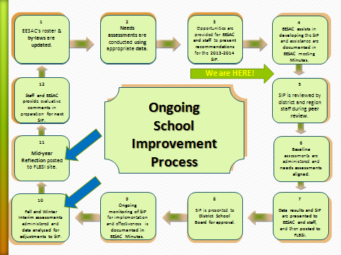
The School Improvement Process

Slide 3
Where We are…….
Everyone has been trained on the development of the 2013-2014 SIP
First draft of the SIP should be entered on the state website, www.flsiponline.com, by September 3, 2013
The Charter school office, along with the OSI staff will review and provide feedback to schools
Schools must have an EESAC meeting and minutes posted that reflect the approval of the 2013-14 SIP prior to posting
Final posting of the SIP will be October 7, 2013

Slide 4
Areas Covered
Elementary
READING - Including AMOs, FAA, CELLA
WRITING - Including FAA
MATHEMATICS - Including AMOs, FAA SCIENCE - Including FAA
STEM
EARLY WARNING SYSTEMS
  ATTENDANCE
  SUSPENSIONS
  RETENTIONS
PARENTAL INVOLVEMENT
Complete CELLA & FAA if 10 or more students were tested
Secondary
READING - Including AMOs, FAA CELLA and Postsecondary Readiness
WRITING - Including FAA
MATHEMATICS - Including AMOs, FAA , and Postsecondary Readiness
  MIDDLE SCHOOL ACCELERATION
  ALGEBRA I
  GEOMETRY
SCIENCE - Including FAA
BIOLOGY I
STEM
CAREER AND TECHNICAL EDUCATION
Social Studies
  CIVICS
  US HISTORY
EARLY WARNING SYSTEMS
  ATTENDANCE
  SUSPENSIONS
  RETENTIONS
  GRADUATION
PARENTAL INVOLVEMENT

Slide 5
New to the SIP This Year-Part I
School Advisory Council included in Part I
Highly Qualified Staff (HQ Paraprofessionals, other instructional personnel)
Increased Learning Time/Extended Learning Opportunities
College & Career Readiness

Slide 6
New to the SIP this year- Part II
Problem Solving Process: Provides the 8 step process to respond to Goal Areas
Florida Alternate Assessment (FAA) – Must be completed by any school with 10 or more students taking this assessment – Appendix IX
CELLA- Must be completed by any school with 10 or more students taking this assessment – Appendix X
Early Warning Systems – divided by school levels: Must be completed by all schools
Middle School Acceleration: Must be completed by all Middle Schools & K-8 Centers

Slide 7
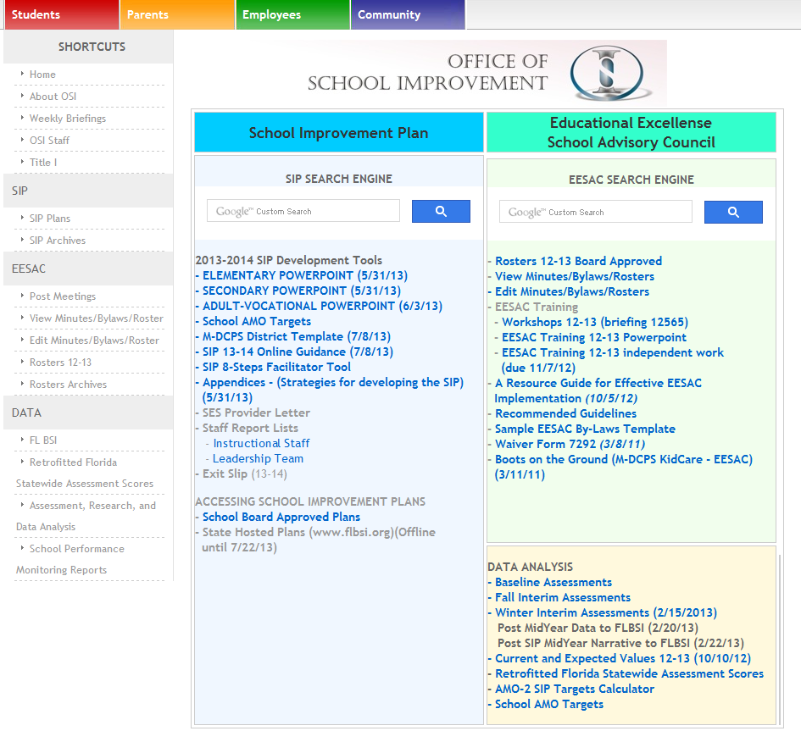
http://osi.dadeschools.net
Click Here

Slide 8
Go to http://www.flsiponline.com and begin entering your SIP online.

Slide 9
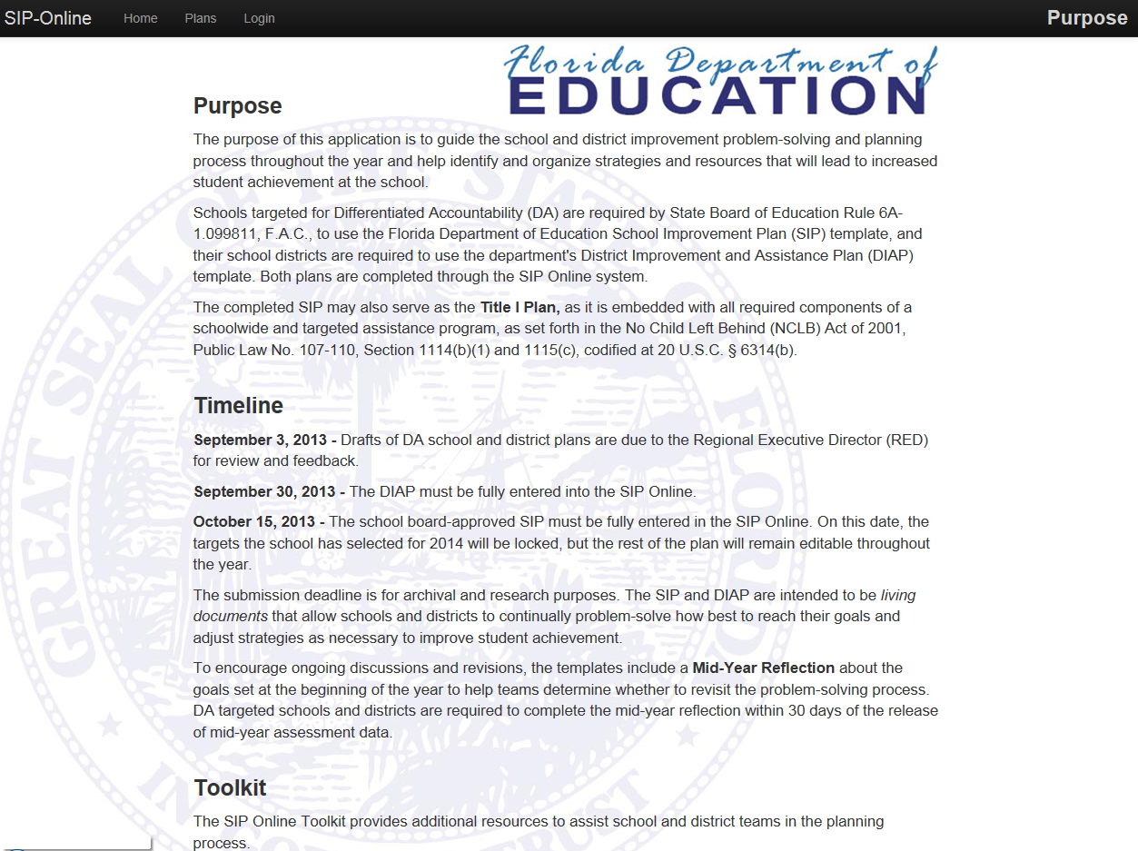

Slide 10
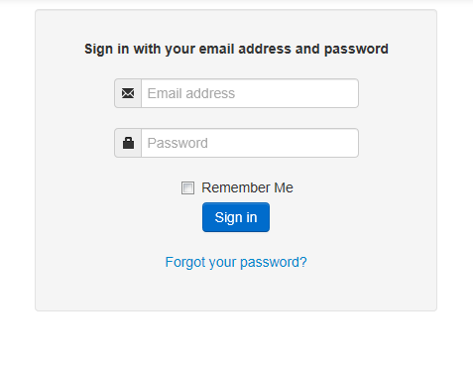
Principal’s email
Refer to Weekly Briefing #14201 – Release date Aug. 15, 2013

Slide 11
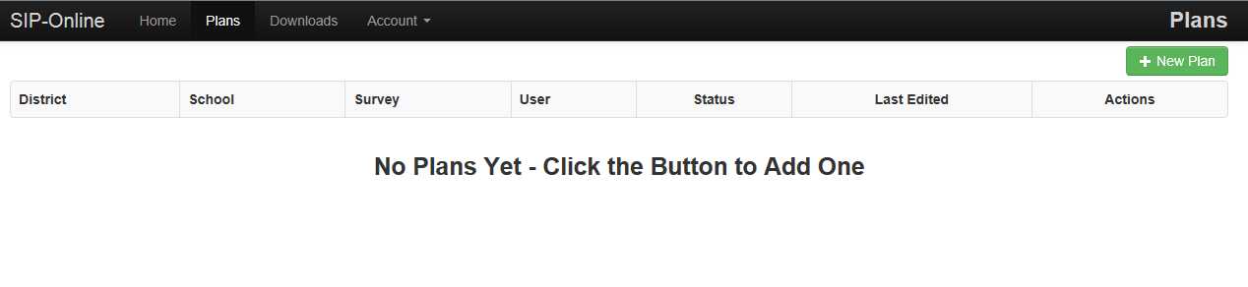

Slide 12
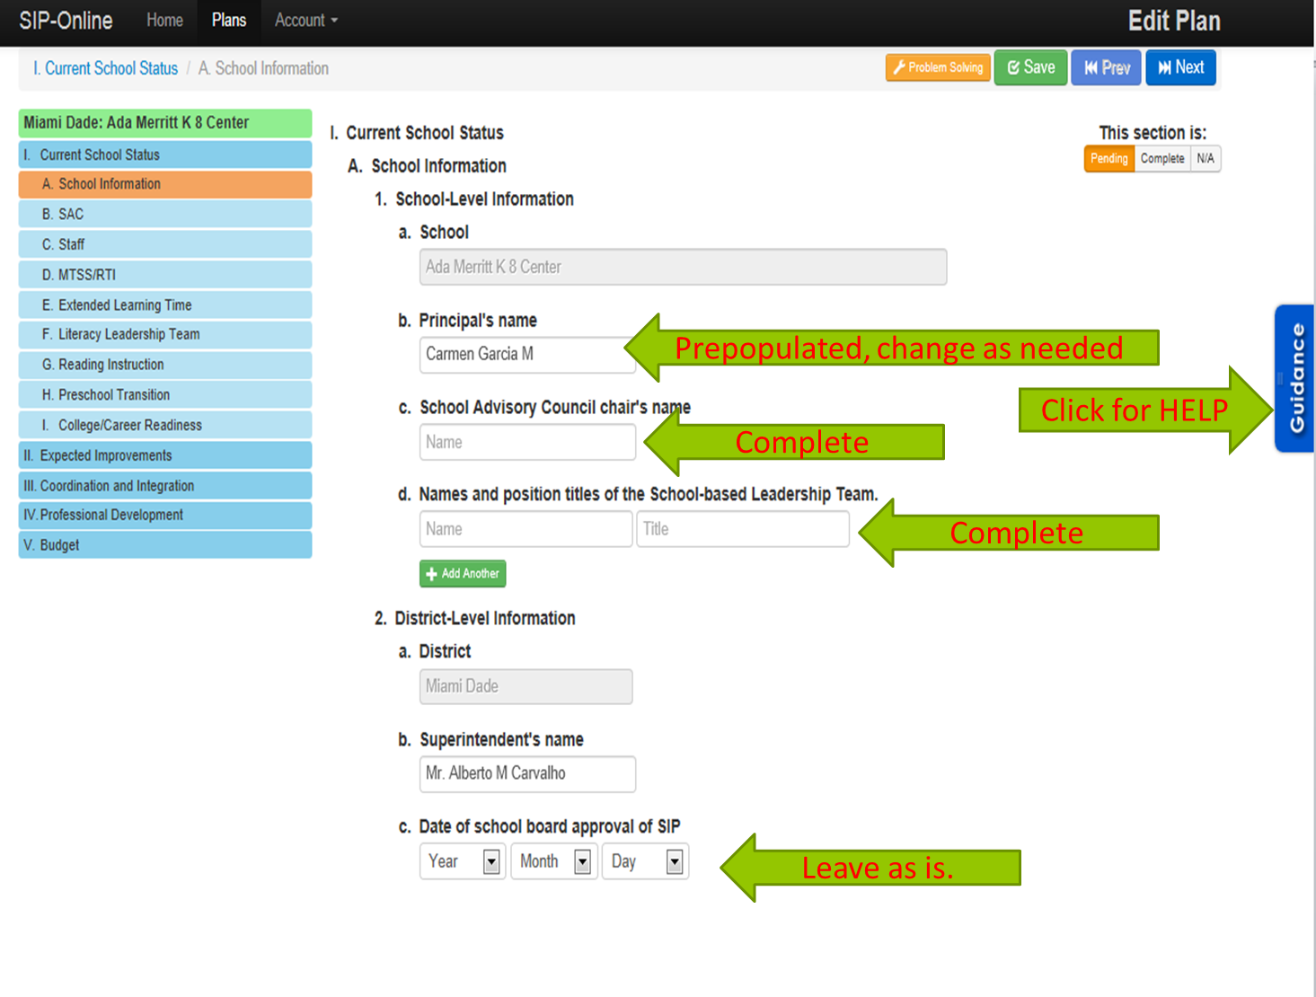

Slide 13
http://osi.dadeschools.net
UPDATES

Slide 14
Planning, Implementing, Monitoring, and Evaluating the SIP Process
This is a team process.
The Charter School Office and the Office of School Improvement can provide assistance.
Communication is ongoing for all stakeholders.
Updates to the SIP can be made throughout the year.
Adhere to the timelines for SIP development.
Provide assurances through EESAC minutes.

Slide 15

Pursuant to Section VI. I. of the contractual agreement, “An Educational Excellence School Advisory Council (EESAC) will be established consistent with Florida Statute 1001.452 to facilitate achievement of the mission of the School, and to ensure that the School meets the needs of the children and community it is developed to serve.
To this end, the School will detail and address the following components, for its EESAC:
(a) establishment of by-laws;
(b) composition of membership;
(c) election procedures; and
(d) communication and posting of meeting agendas and minutes pursuant to Florida Statute 286.011 (Sunshine Law).
Charter Schools

Slide 16
School Advisory Councils (EESACs)
The School Advisory Council is responsible for final decision making at the school relating to the implementation of the provisions of the annual School Improvement Plan.
Each School Advisory Council assists in the annual preparation and evaluation of the School Improvement Plan (SIP) and in the preparation of the school's annual budget.
  Majority of members must be non-District employees
  Schedule appropriate meetings (5 Day notice) through Citizens’ Information website
  New charter schools for 2013-2014 must create an EESAC.
    Contact the OSI office for assistance in:
      Developing Bylaws;
      Creating Rosters; and
      Posting meeting requests and minutes

Slide 17
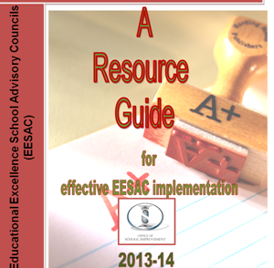
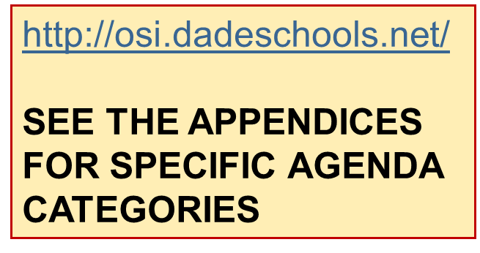
EESAC AGENDA & RESOURCES

Slide 18
MAKING THE CONNECTION
SIP & EESAC
Minimum number of meetings:
  For non-DA (A and B) schools - 4 per school year, one per grading period
  DA schools (Focus and Priority) and “C” schools monthly in order to monitor and monitor progress
Include SIP and Data Reviews on every EESAC Meeting Agenda
Document SIP reviews and decisions in EESAC Minutes
Include SIP on Faculty Meeting Agendas
Minimum Requirements for Five Star Award: A minimum of 8 of EESAC meetings with 80% of members in attendance

Slide 19
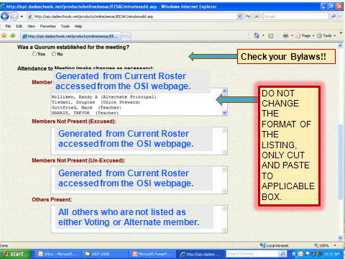
Post Minutes within 7 Days of Meeting

Slide 20

OSI EESAC RESOURCES
http://osi.dadeschools.net/
Notes:
Please note that the View and Edit buttons also access the ROSTERS
the Post a Meeting Link gives you immediate access to the Citizens’ Info page

Slide 21
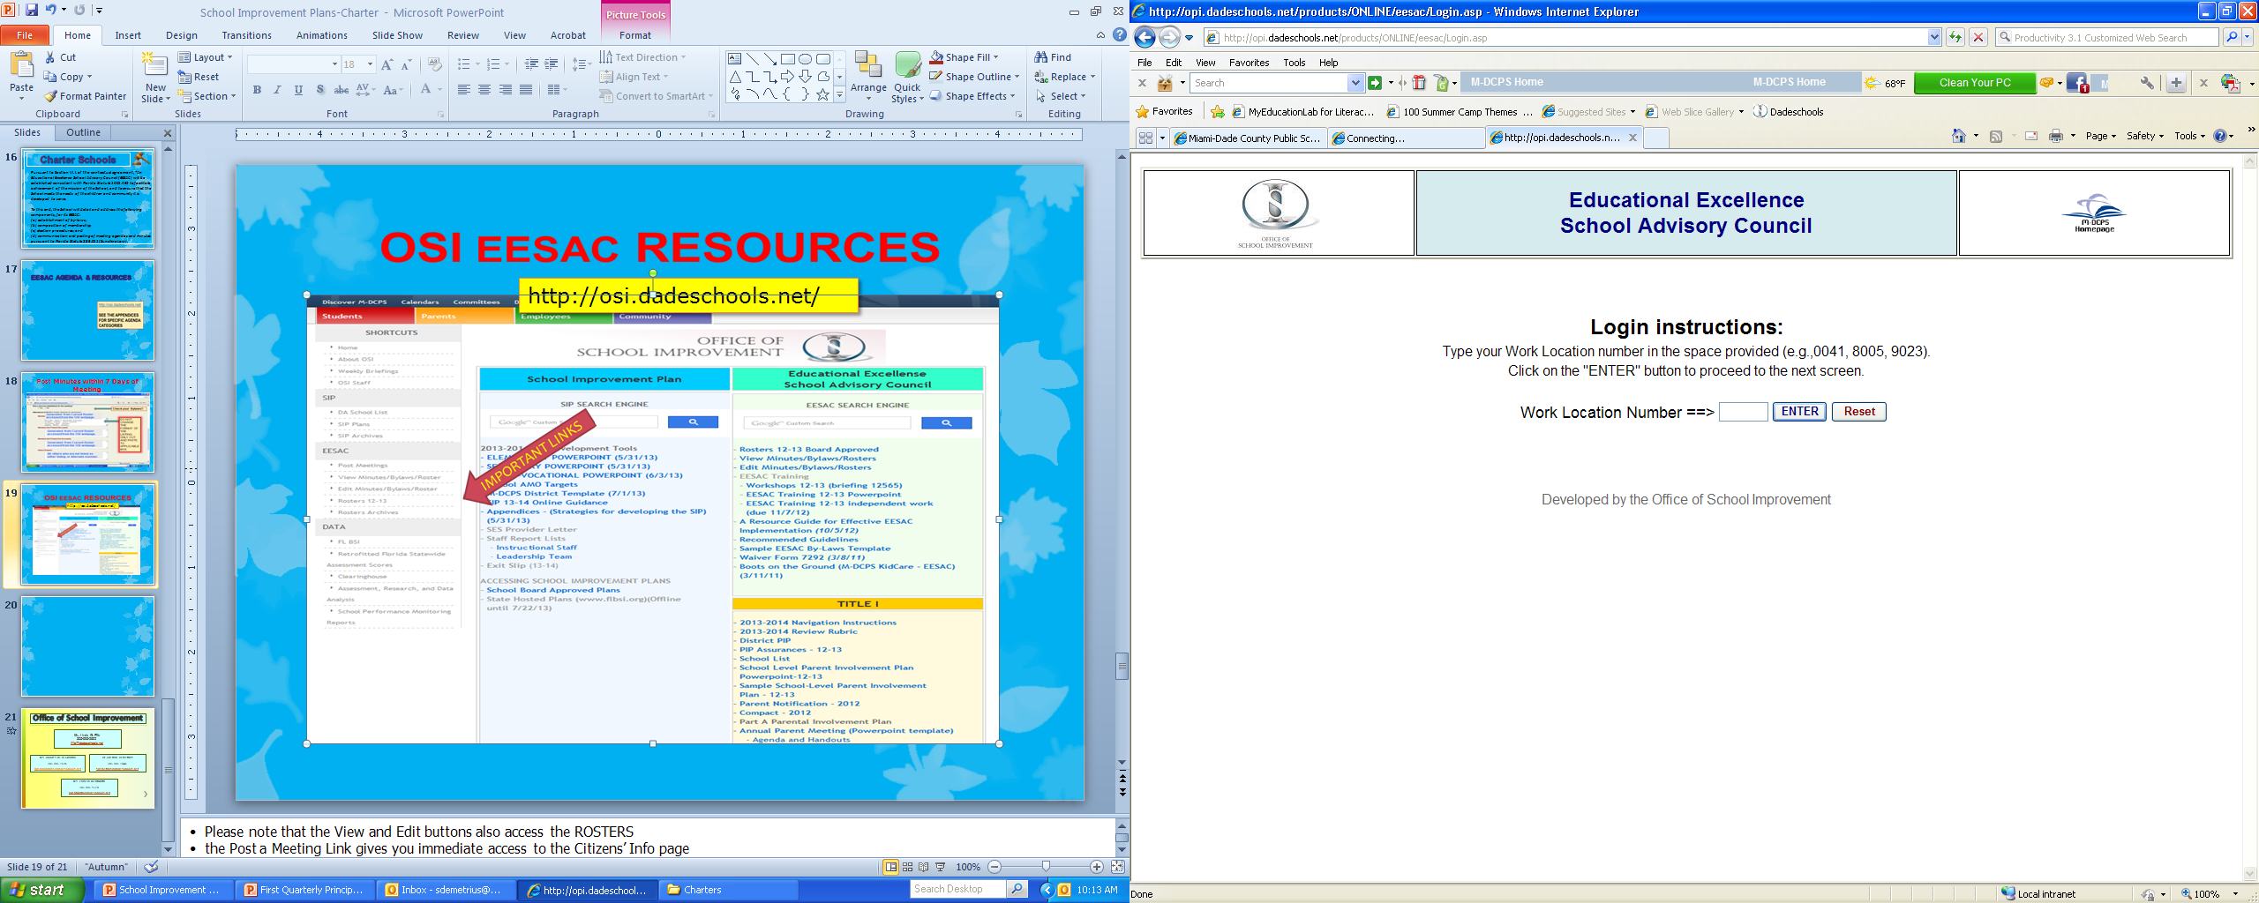
ACCESSING YOUR EESAC

Slide 22
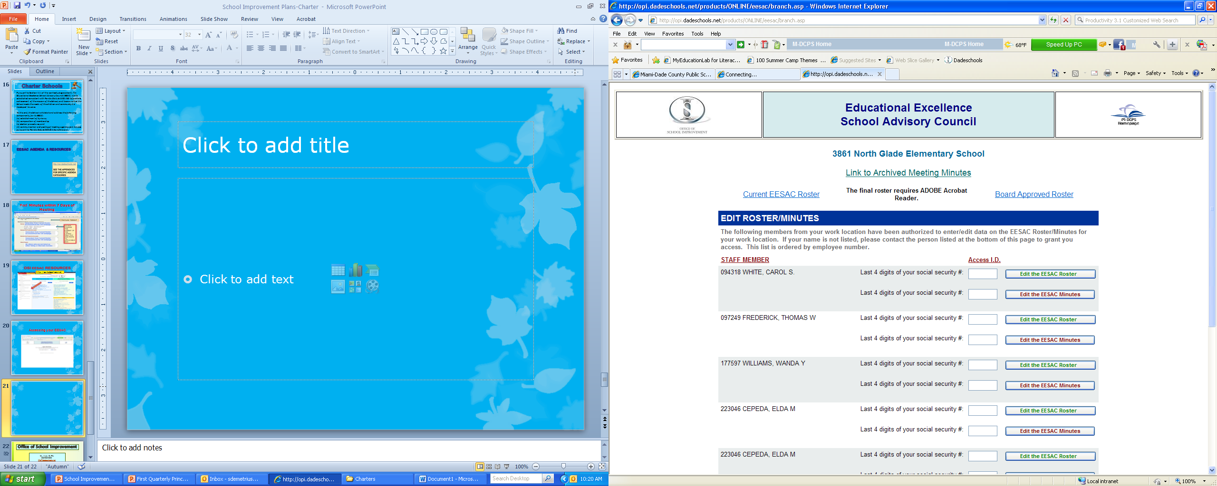
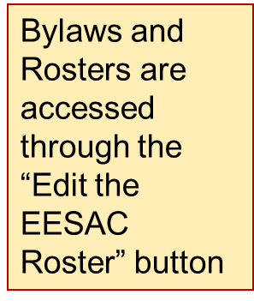

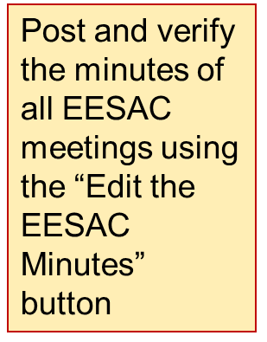
BYLAWS & ROSTERS

Slide 23
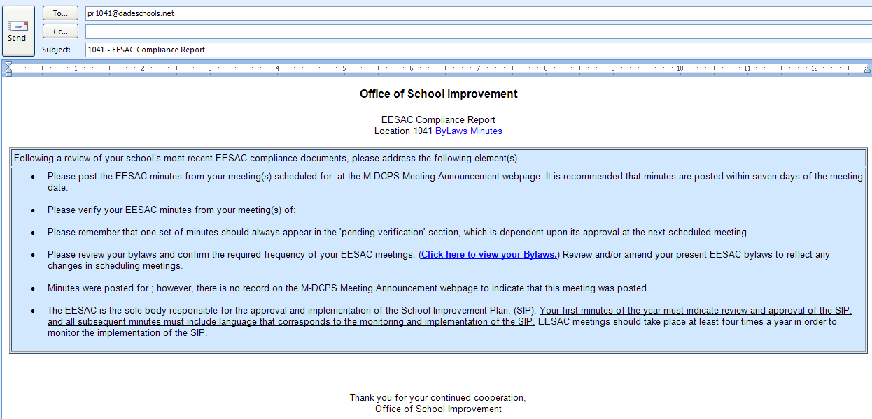
EESAC Compliance Report
(You will receive this report if your school’s EESAC minutes/bylaws/roster are out of compliance.)

Slide 24
EESAC TRAININGS
CHECK THE OSI WEBSITE FOR TRAINING DATES &TIMES
(OCTOBER 2013)

Slide 25





